Slide 1
Data Processing and Visualization using MATLAB
Jerry Huang
Research Technology Group, Institute for Digital Research and Education
May 12, 2020

Slide 2
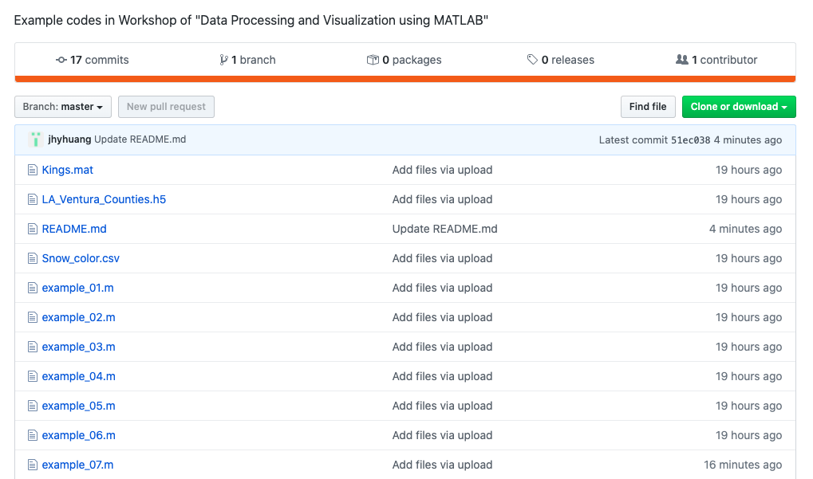
Getting started
A programming language, an advanced calculator, and an graphic tool.
No cost for all UCLA users and is also available on Hoffman2 cluster.
Installation on personal desktop/laptop
https://softwarecentral.ucla.edu/matlab-getmatlab
Many toolboxes are available for different applications.
All examples and this presentation are available at:
https://github.com/jhyhuang/idre_matlab_dp_vis

Slide 3
Basic of MATLAB interface

Slide 4
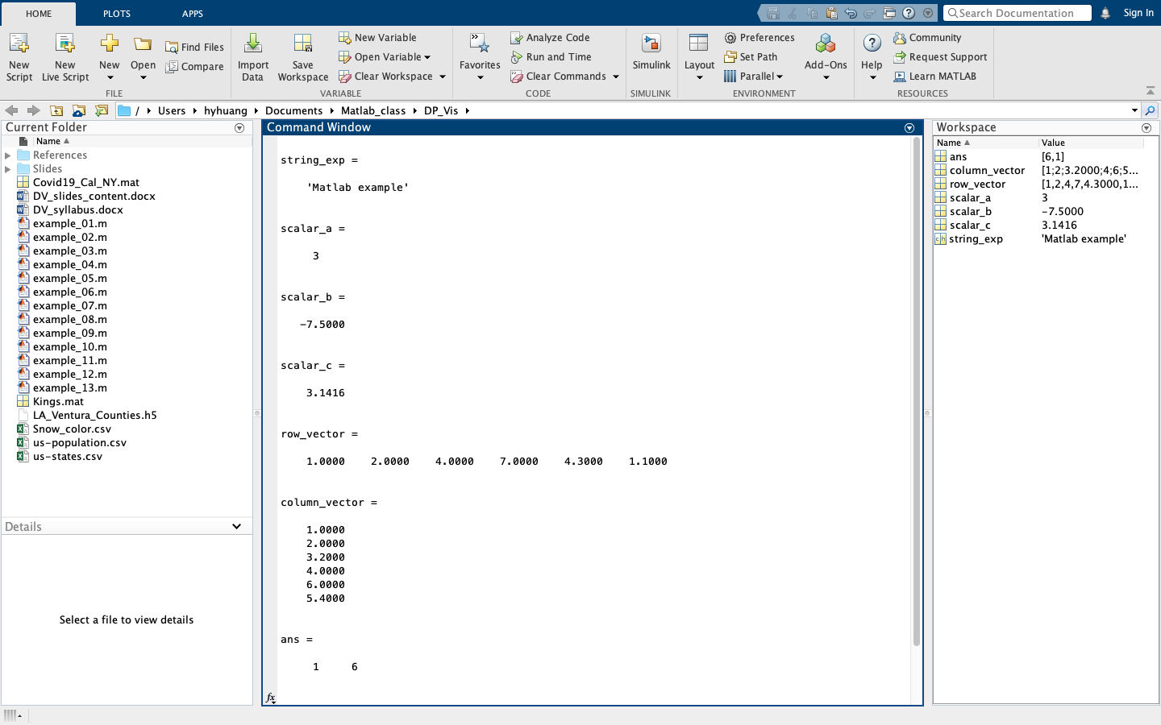
MATLAB graphic interface
Key feature !!
Command window
Workspace
Current
directory
Details

Slide 5
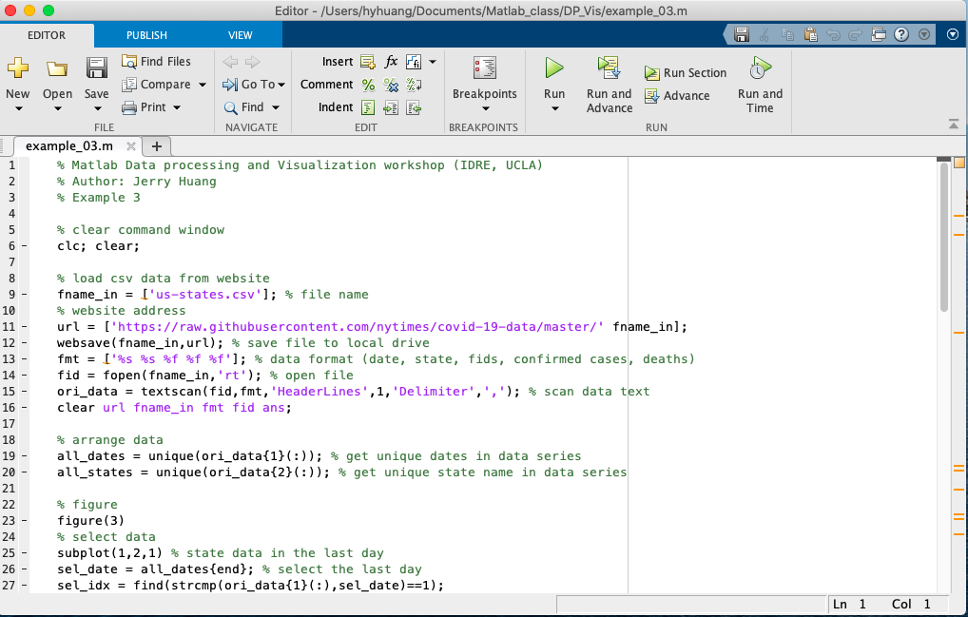
MATLAB .m file editor

Slide 6
Data processing and visualization

Slide 7
Data processing
Data preparation
simulation, observation, downloading, collection, sampling, creation
Data input
number in table, common separate values (csv), mat, hdf5
Data arranging
sorting, ranking, arranging, finding
Data processing
statistical processing, missing data, outliers, fitting
Data visualization
graphic plotting, animation, storage

Slide 8
Data processing
Data preparation
simulation, observation, downloading, collection, sampling, creation
Data input
number in table, common separate values (csv), mat, hdf5
Data arranging
ranking, sorting, arranging, finding
Data processing
outliers, statistical processing, missing data, fitting
Data visualization
storage, graphic plotting, animation,

Slide 9
Data preparation
simulation, observation, downloading, collection, sampling, creation

Slide 10
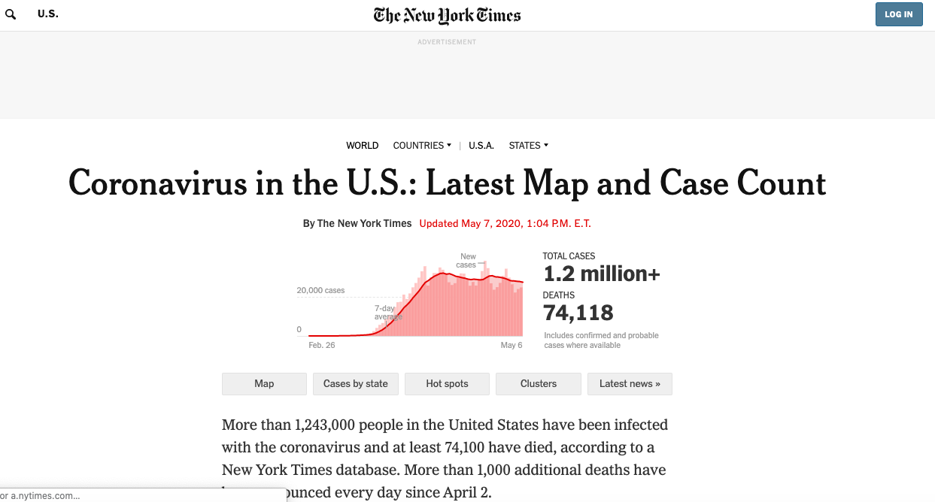
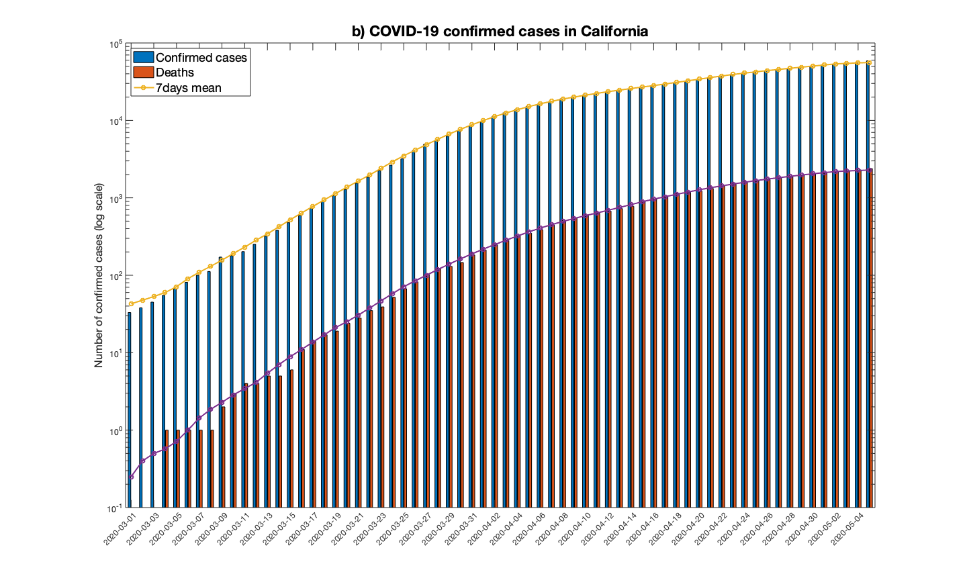
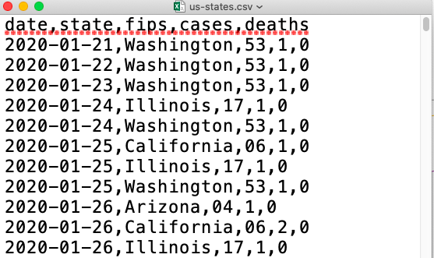
California COVID-19 cases
https://github.com/nytimes/covid-19-data

Slide 11
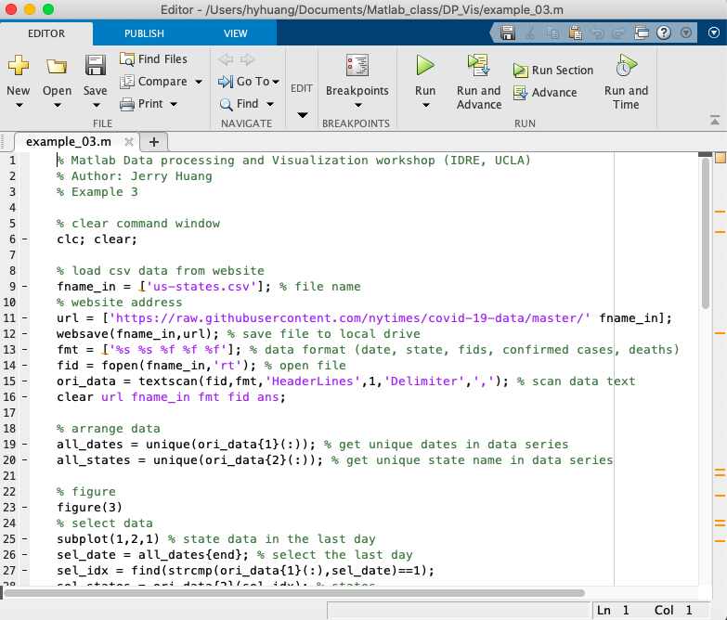
Download data file directly from website
example_03.m
fname_in = ['us-states.csv'];
url = ['https://raw.githubusercontent.com/nytimes/covid-19-data/master/' fname_in];
websave(fname_in,url);
fmt = ['%s %s %f %f %f’];
fid = fopen(fname_in,'rt’);
ori_data = textscan(fid,fmt,'HeaderLines',1,'Delimiter',',');

Slide 12
Data input
common separate values (csv), number in table, mat, hdf5

Slide 13
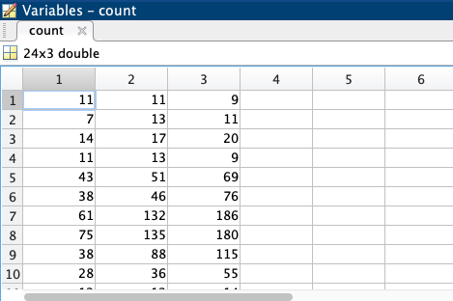
Import numbers in a table
example_02.m
Matlab built-in dataset “count.dat”
fname_in = [‘count.dat’];
load fname_in;

Slide 14
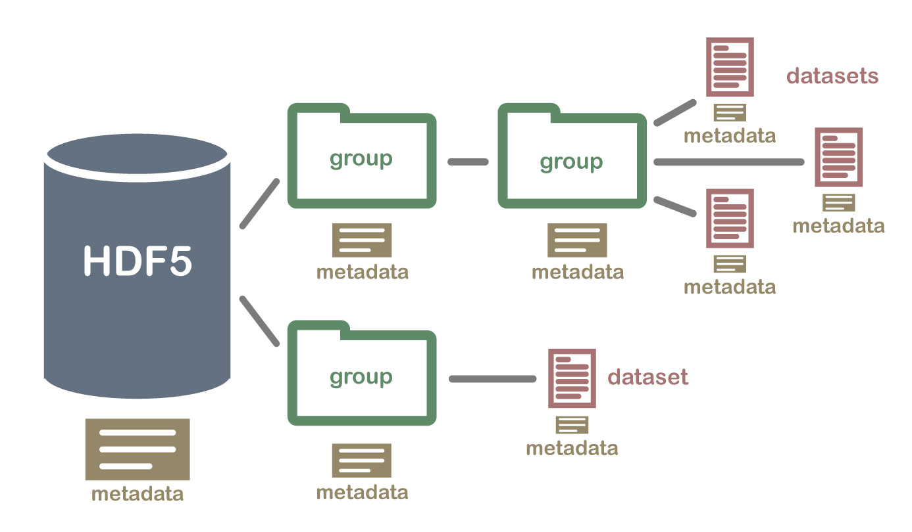
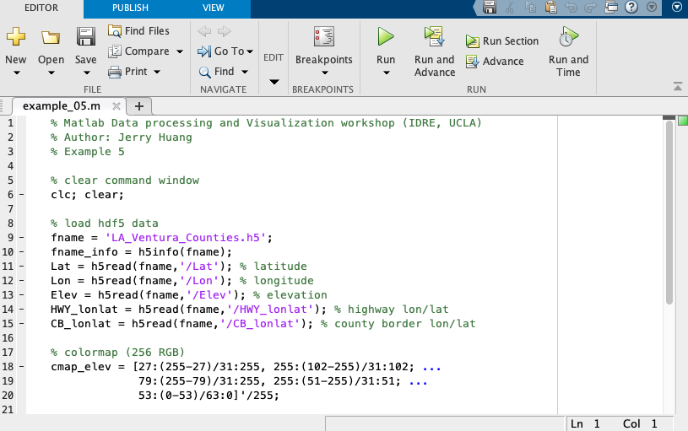
Import data in hdf5 (hierarchical data format)
example_05.m
https://www.neonscience.org/about-hdf5
# LA and Ventura counties map
fname = 'LA_Ventura_Counties.h5’;
fname_info = h5info(fname);
Lat = h5read(fname,'/Lat'); % latitude
Elev = h5read(fname,'/Elev');

Slide 15
Data arranging
ranking, sorting, arranging, finding

Slide 16
Find unique variables and sort
example_03.m
all_states = unique(ori_data{2}(:));
all_dates = unique(ori_data{1}(:));
Exp:
data_sorted = sort(data);

Slide 17
Data processing
outliers, statistical processing, missing data, fitting

Slide 18
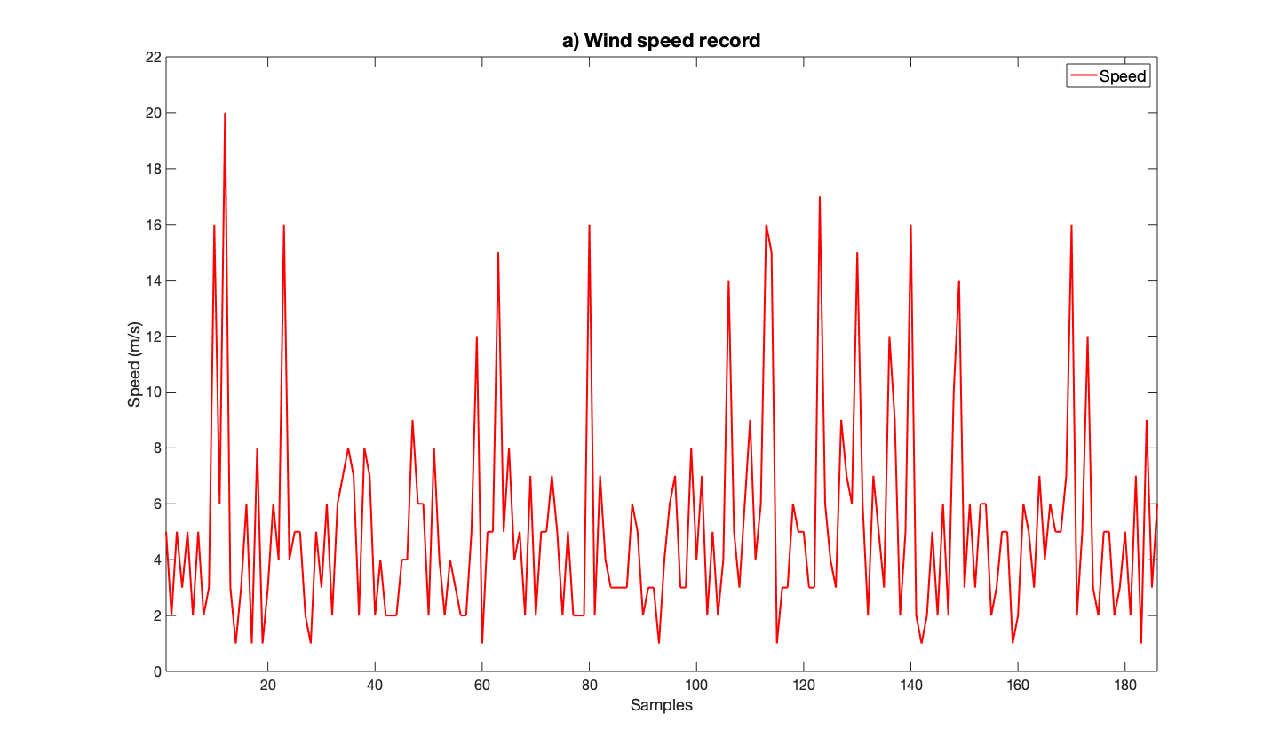
Basic statistical processing
example_06.m
Time series of wind speed records, Matlab built-in dataset “windData.mat”
plot(speed)

Slide 19
Basic statistical processing
Maximum and minimum
max(speed)
min(speed)

Slide 20
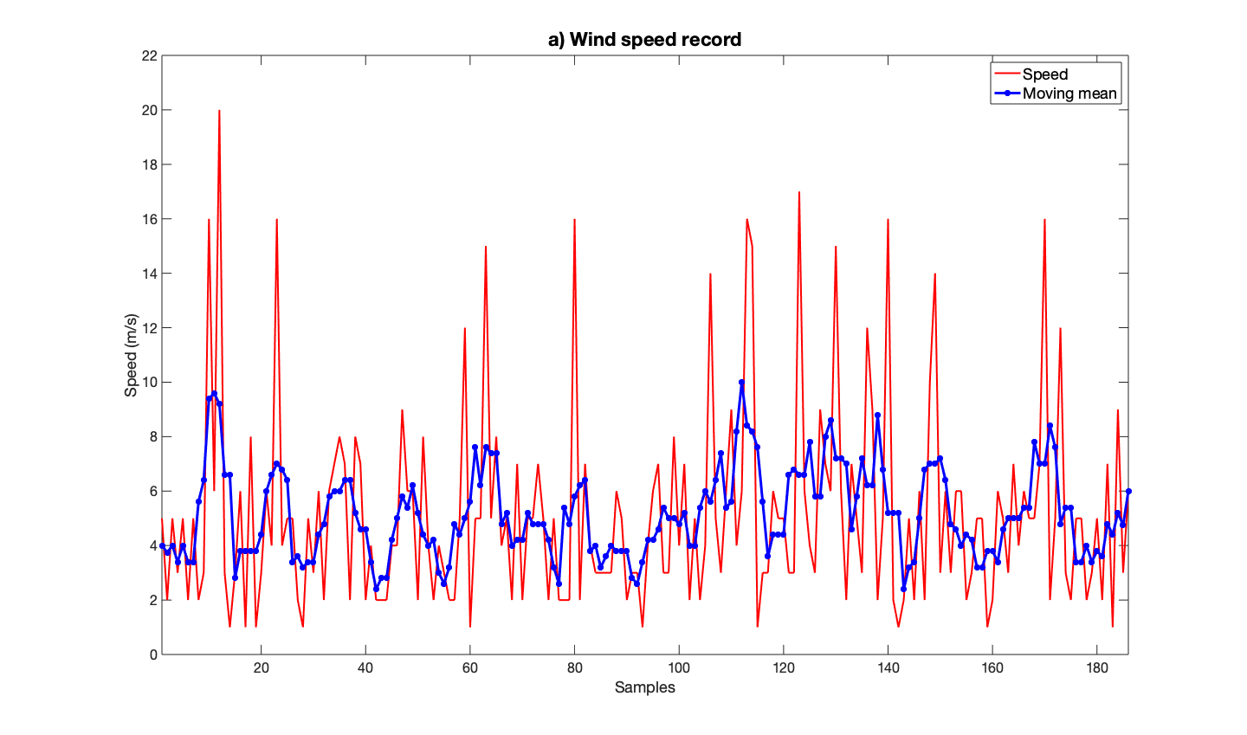
Data processing (i)
Basic statistical functions
Moving mean, mean, and standard deviation
mean(speed)+std(speed)
mean(speed)
movmean(speed,5)

Slide 21
Basic statistical processing
Combine multiple data series
The original data set, wind speed

Slide 22

Basic statistical processing
Combine multiple data series
Use yyaxis left for the first dataset (wind speed)
yyaxis left

Slide 23
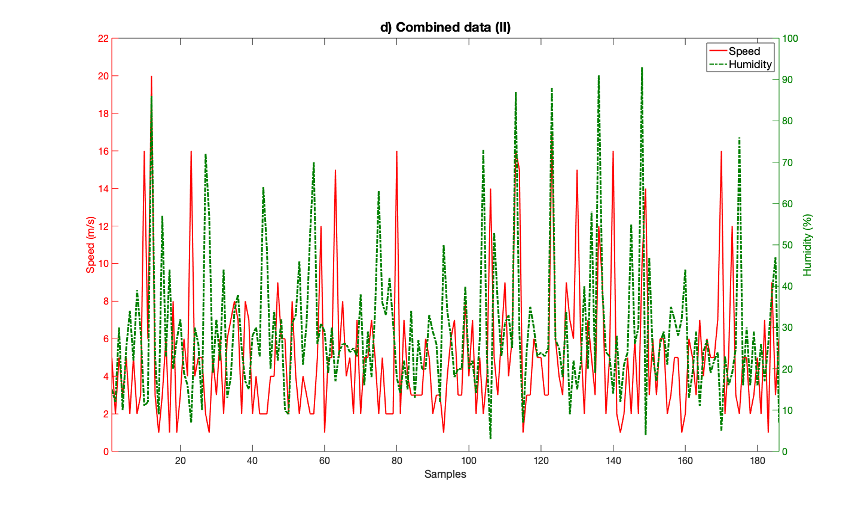
Basic statistical processing
Combine multiple data series
Add yyaxis right for the second dataset (humidity)
yyaxis right
Correlation_coefficient=
corrcoef(speed,humidity)

Slide 24
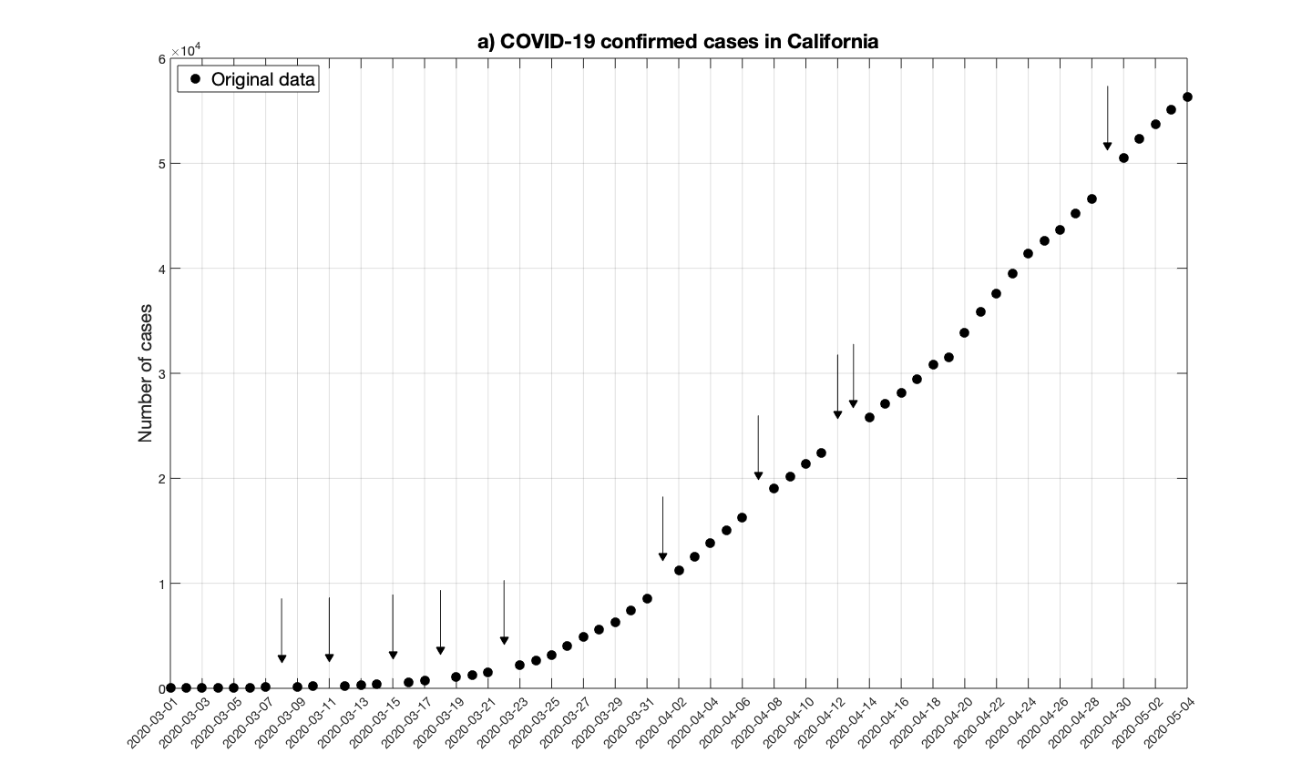
Deal with missing data
example_08.m
California COVID-19 confirmed case data from example_03
Xtickangle(45)

Slide 25
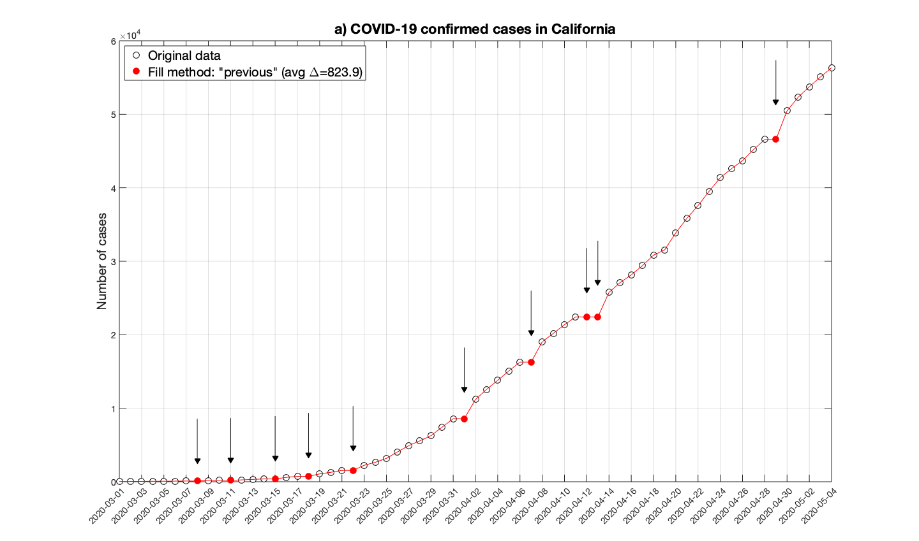
Deal with missing data
Fill missing data by the method “previous”
fm_method_1 = 'previous';
Cal_cases_previous = fillmissing(Cal_cases_missing,fm_method_1);

Slide 26
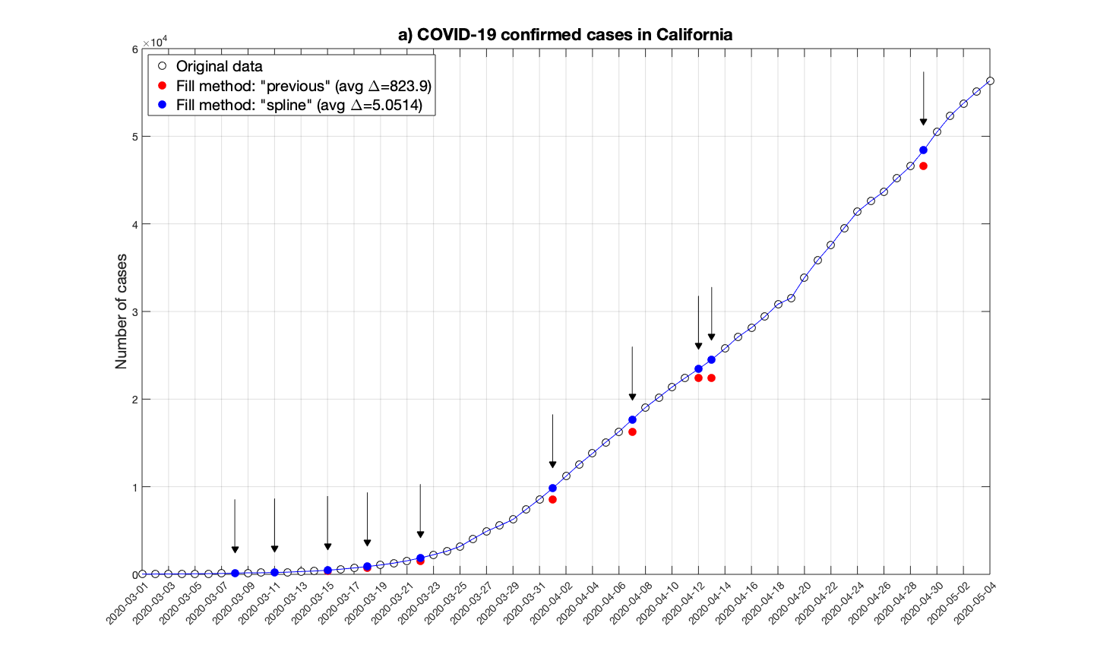
Deal with missing data
Fill missing data by the method “spline”
fm_method_3 = ‘spline';
Cal_cases_previous = fillmissing(Cal_cases_missing,fm_method_3);

Slide 27
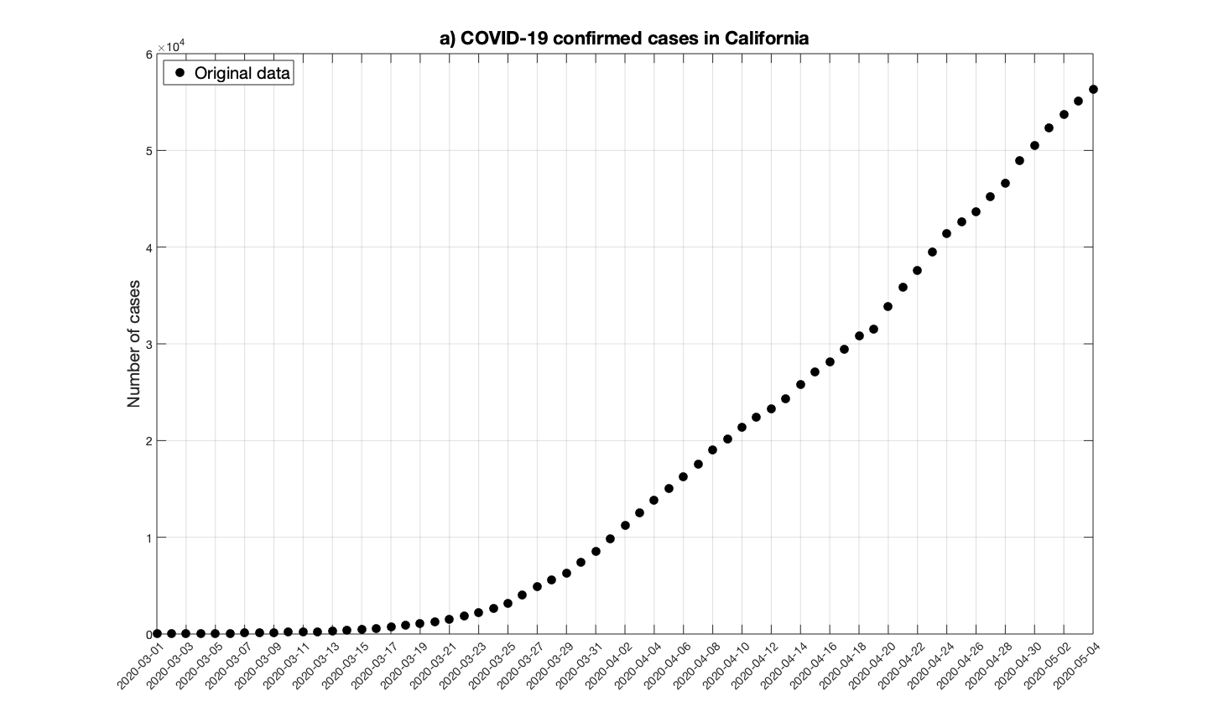
Data fitting
example_10.m
California COVID-19 confirmed case data from example_03
Can we use a mathematical equation to mimic this profile?

Slide 28
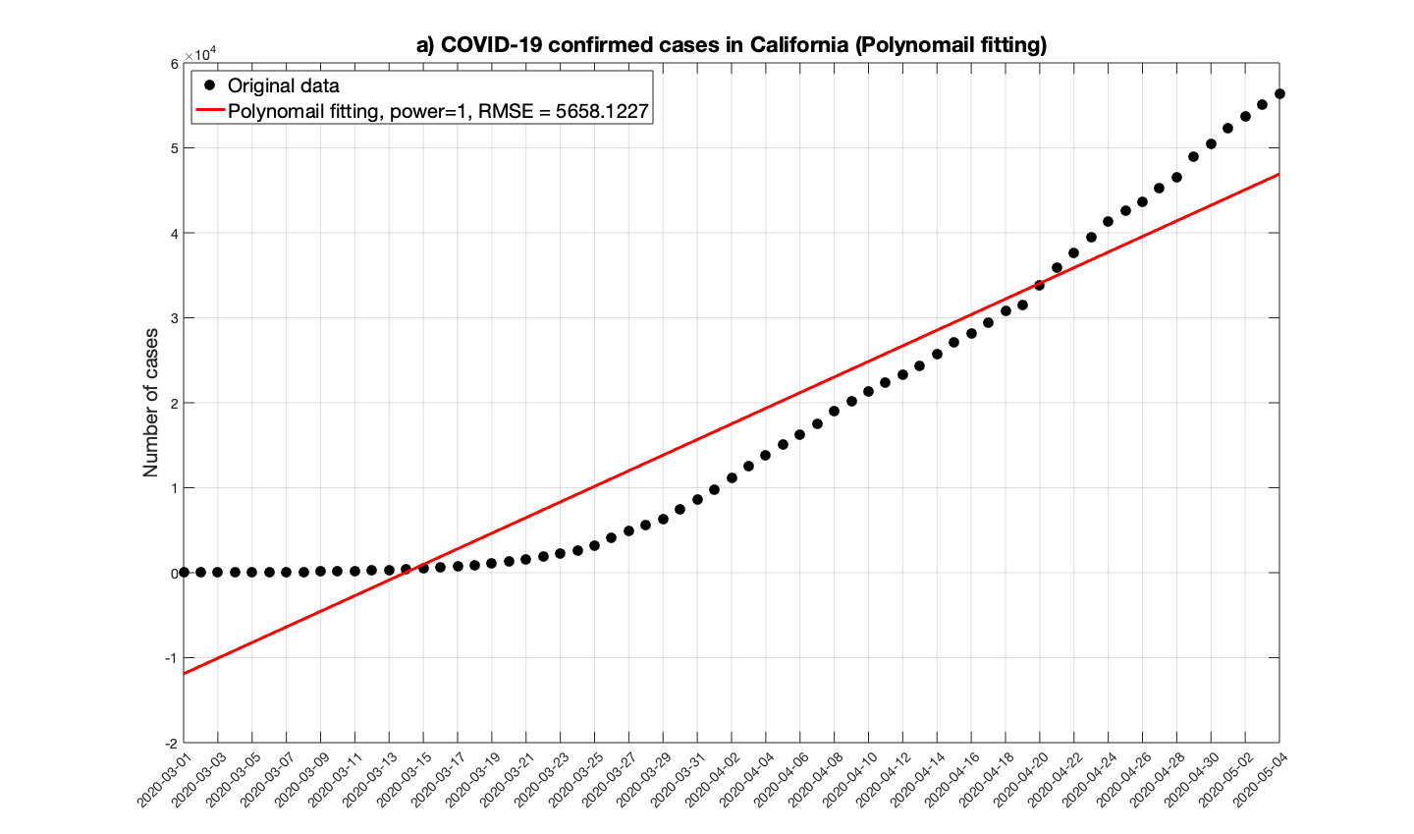
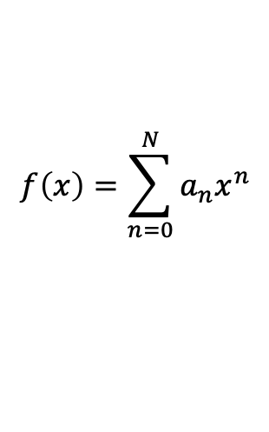
Data fitting
Polynomial fitting, N = 1
$$f\left(x\right)=\sum_{n=0}^{N}{a_{n}x^{n}}$$
x = [1:length(Cal_dates)]’;
PnF1 = polyfit(x,Cal_confirmed,1); % power = 1

Slide 29
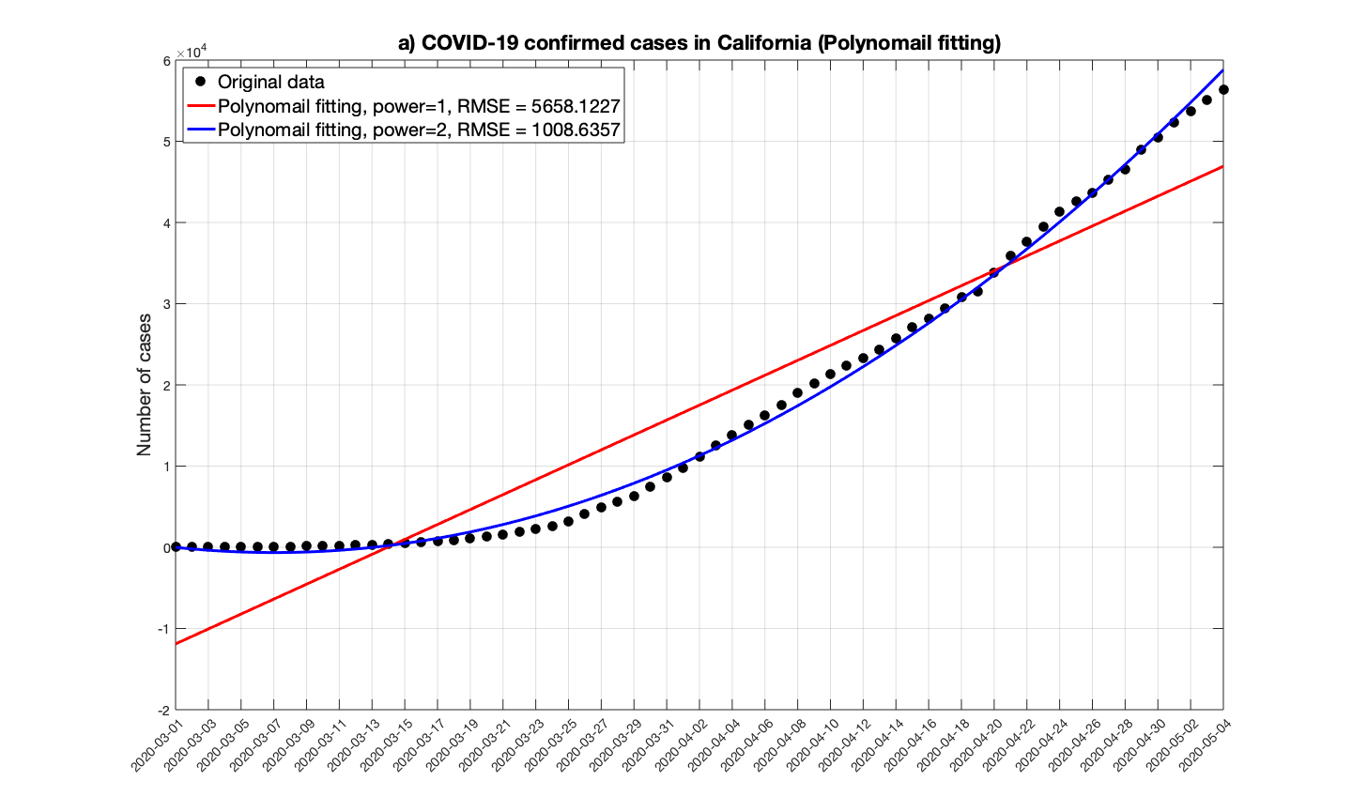
Data fitting
Polynomial fitting, N = 2
$$f\left(x\right)=\sum_{n=0}^{N}{a_{n}x^{n}}$$
x = [1:length(Cal_dates)]’;
PnF1 = polyfit(x,Cal_confirmed,1); % power = 1
PnF2 = polyfit(x,Cal_confirmed,2); % power = 2

Slide 30
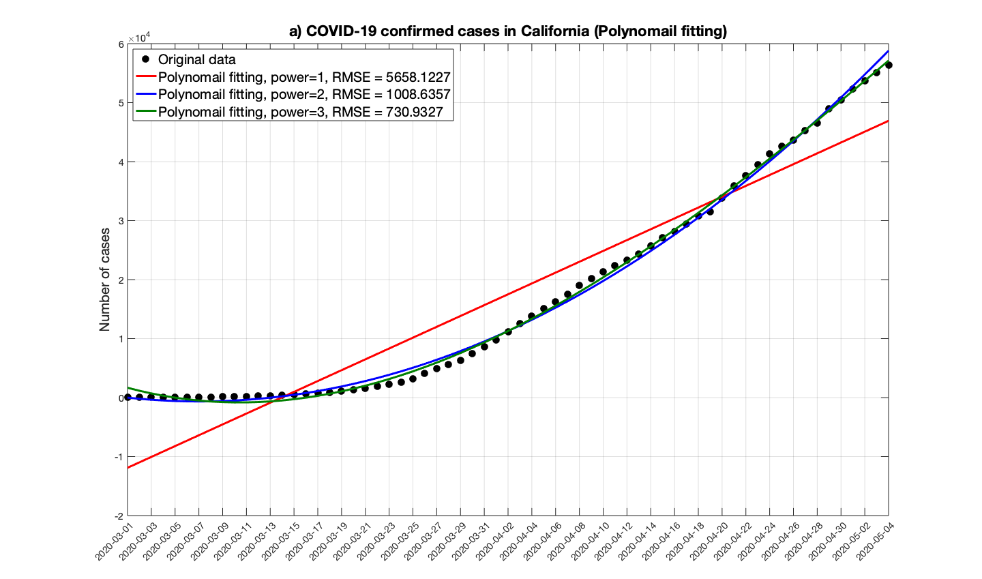
Data fitting
Polynomial fitting, N = 3
$$f\left(x\right)=\sum_{n=0}^{N}{a_{n}x^{n}}$$
x = [1:length(Cal_dates)]’;
PnF1 = polyfit(x,Cal_confirmed,1); % power = 1
PnF2 = polyfit(x,Cal_confirmed,2); % power = 2
PnF3 = polyfit(x,Cal_confirmed,3); % power = 3

Slide 31
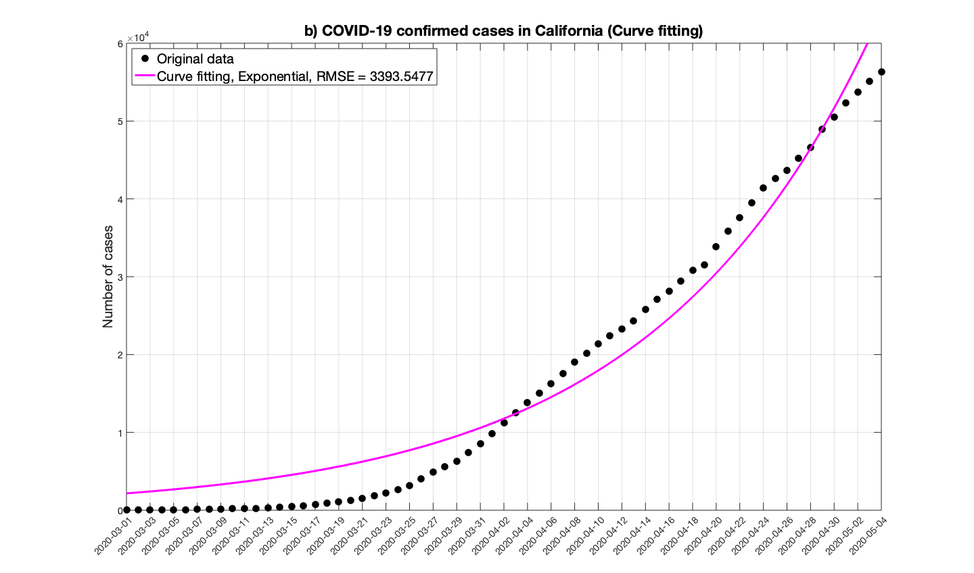
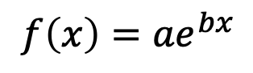
Data fitting
Curve fitting, using exponential function
$${f\left(x\right)=ae}^{bx}$$
x = [1:length(Cal_dates)]’;
CF_exp1 = fit(x,Cal_confirmed,’exp1’);

Slide 32
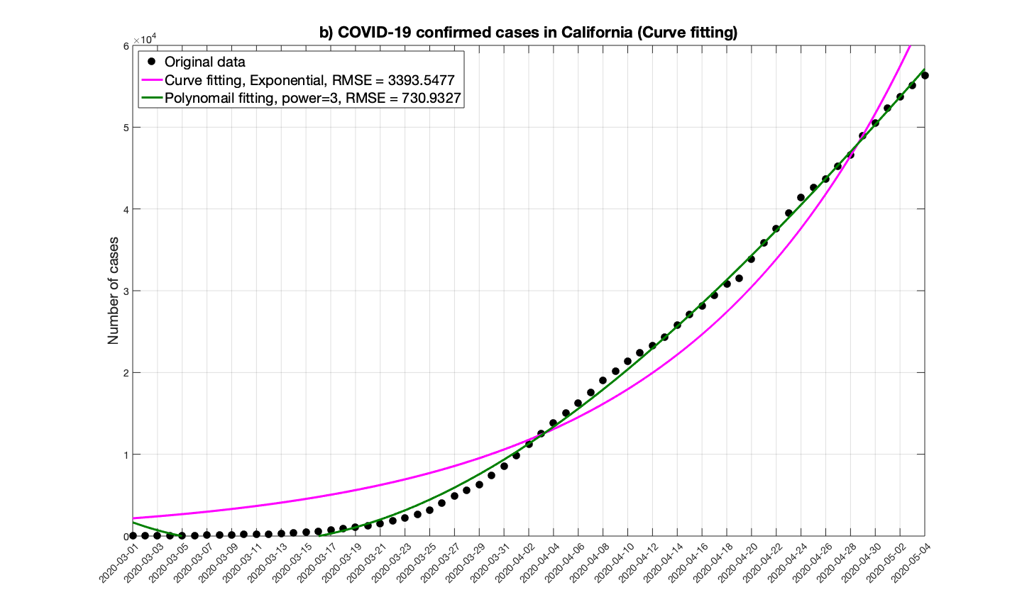
Data fitting
Comparison between exponential curve fitting and polynomial fitting
x = [1:length(Cal_dates)]’;
CF_exp1 = fit(x,Cal_confirmed,’exp1’);
PnF3 = polyfit(x,Cal_confirmed,3);

Slide 33
Data visualization
storage, graphic plotting, animation,

Slide 34
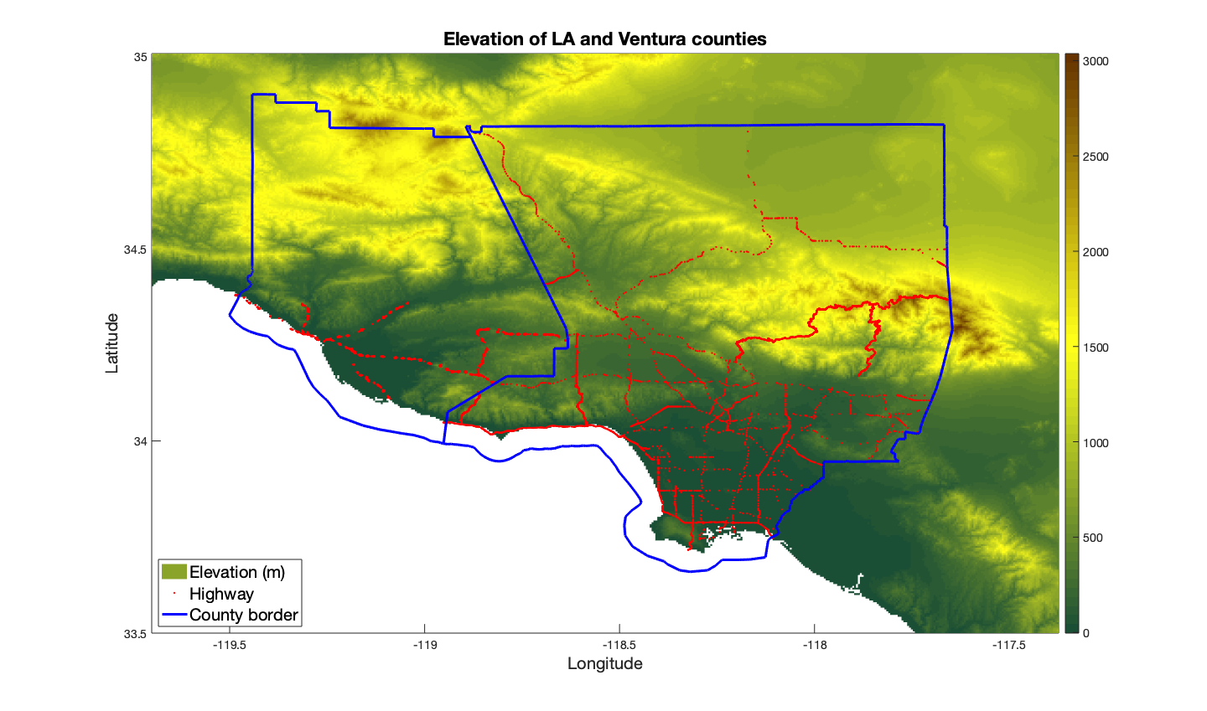
2D graphical plotting
example_05.m
LA and Ventura counties map
fname = 'LA_Ventura_Counties.h5’;
fname_info = h5info(fname);
Lat = h5read(fname,'/Lat'); % latitude
Elev = h5read(fname,'/Elev');
size of each variable is 480 (rows) by 320 (cols)
pcolor(Lon,Lat,Elev); shading flat;

Slide 35
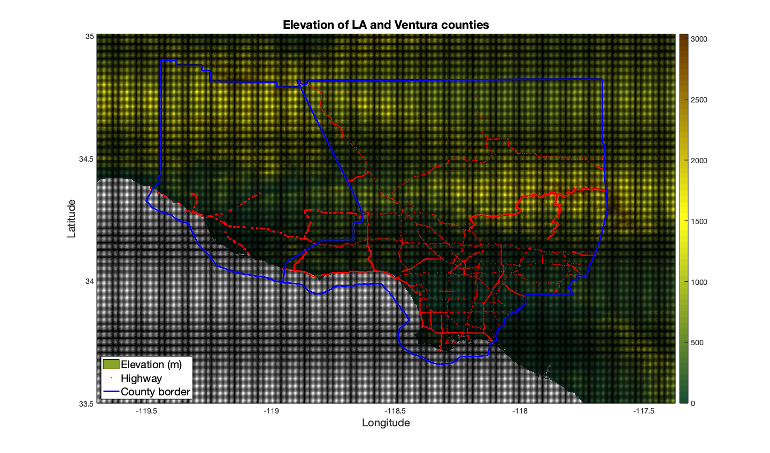
2D graphical plotting
With “shading flat” and without

Slide 36
2D fill plotting
example_04.m
Wind flow through over a rectangular channel
pcolor
fill cells (with a similar value) by a color
pcolor(x,y,velocity); shading flat;
contourf
fill a contour (with a similar value) by a color
contourf(x,y,velocity); shading flat;
colorbar

Slide 37
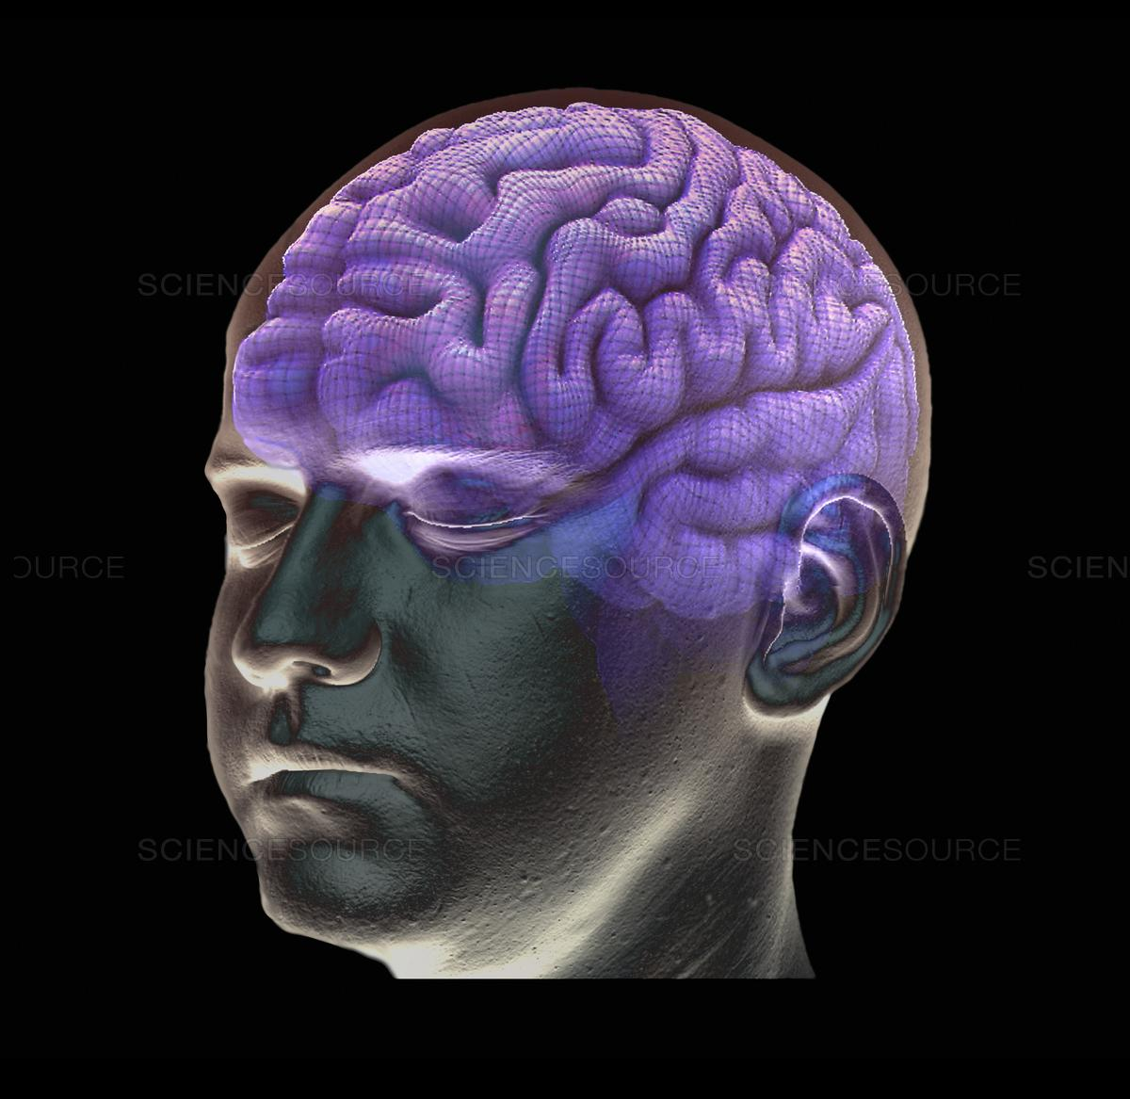
Selection of plotting function and colormap
example_11.m
Brain MRI images, Matlab built-in database “mri”
22
15
8
1
https://www.sciencesource.com/archive/Healthy-brain--3D-MRI-scan-SS2763640.html#/SearchResult&ITEMID=SS2763640

Slide 38
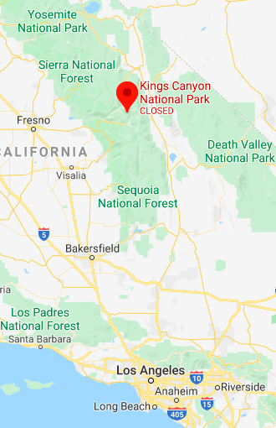
Multiple colormaps
example_12.m
Snow cover in the Kings Canyon

Slide 39
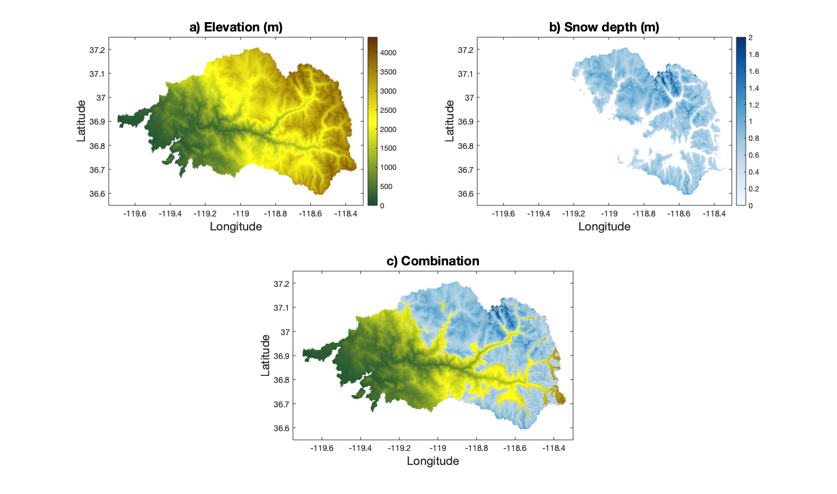
Overlap of colormaps
example_12.m
ax1 = subplot(2,2,3); % elevation plot
ax2 = axes; % snow plot
linkaxes([ax1 ax2]);
set(ax2,'Color','none','Visible','off’);
colormap(ax1,cmap_elev);
colormap(ax2,cmap_snow);
set([ax1,ax2],'Position',ax1_pos);

Slide 40
3D filling plots
example_04.m
wind flow thought a rectangular channel

Slide 41
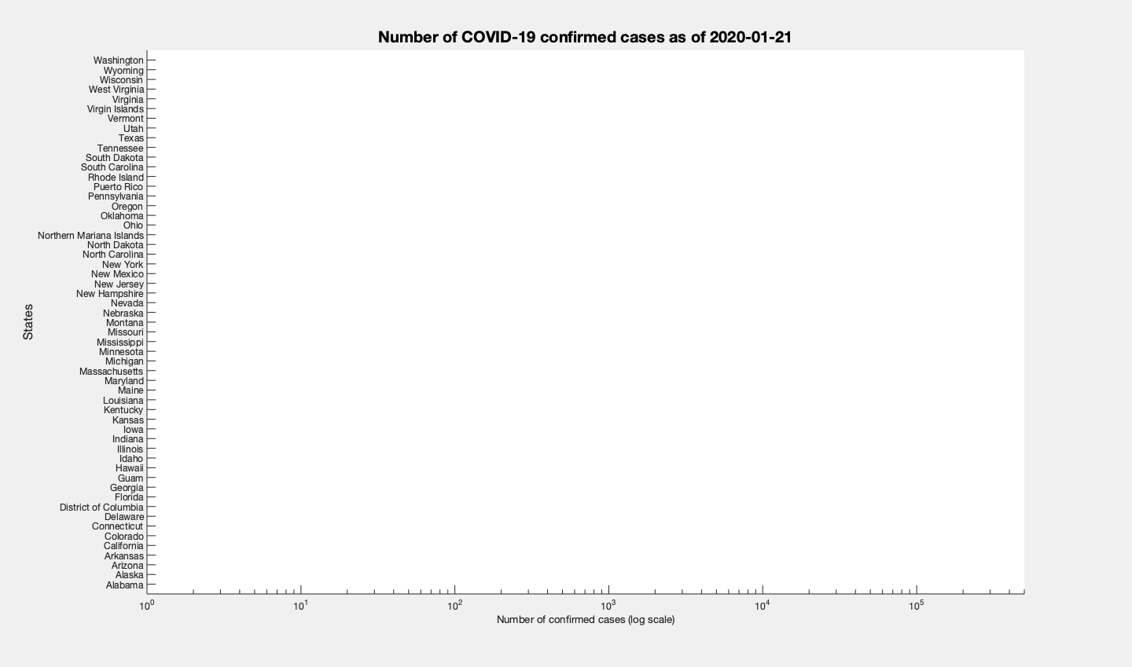
Animation
example_13.m
COVID-19 cases of each state

Slide 42
Flowchart to make an animation
Make a horizontal barplot
[ barh ]
Create a figure
[ h=figure ]
Keep same axis
[axis tight manual ]
Overlap figures
[ hold on ]
Write image to file
[ imwrite ]
Get frame
[ getframe ]
Set color for image
[ rgb2ind ]
Convert frame to image
[ frame2im ]

Slide 43
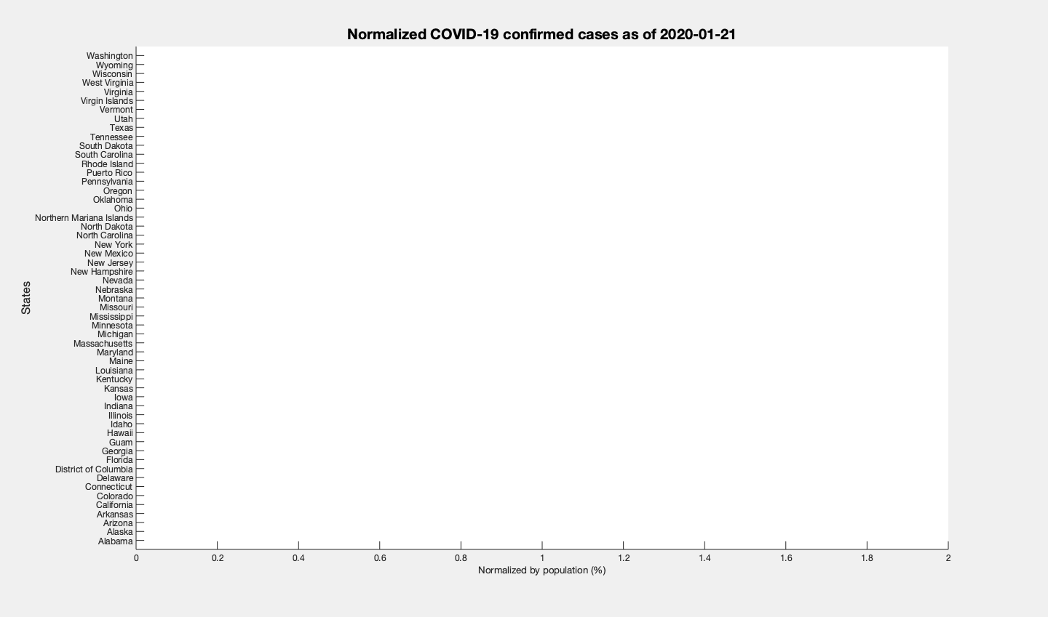
Animation
example_13.m
COVID-19 cases of each state (normalized by population)

Slide 44
Thank you. Questions? Jerry Huang (hyhuang@idre.ucla.edu) IDRE RTG

